Slide 1
Graphical State-Space Programmability as a Natural Interface for Robotic Control
Anqi Xu, Gabriel Charette, Junaed Sattar, Gregory Dudek
McGill University, Canada
Thursday, May 6th, 2010

Slide 2
Overview
Existing robot programming techniques
Graphical State-Space Programming (GSSP)
Implementation on a representative robotic platform
User Study
Anqi Xu, McGill University

Slide 3
Aqua: A Family of Underwater Robots
Survey health of marine
ecosystems
Location-specific tasks:
“Take picture of this coral”
“Search for that type of fish”
Infrastructure representative of most robotic platforms
Anqi Xu, McGill University

Slide 4
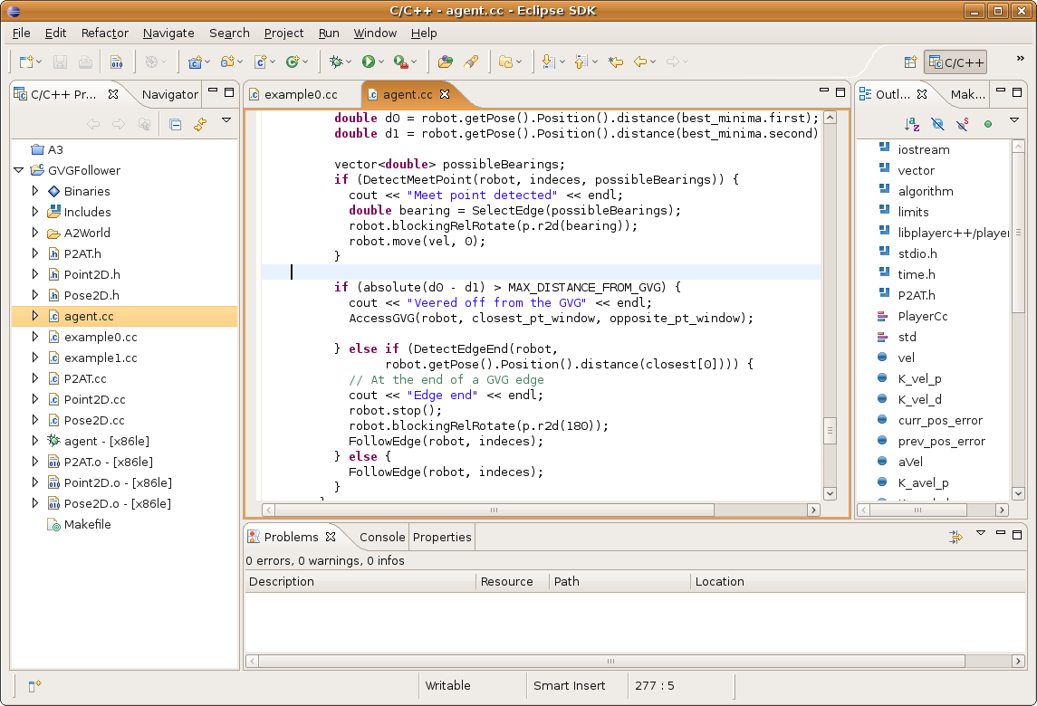
Robot Programming Interfaces
Textual programming
Anqi Xu, McGill University

Slide 5
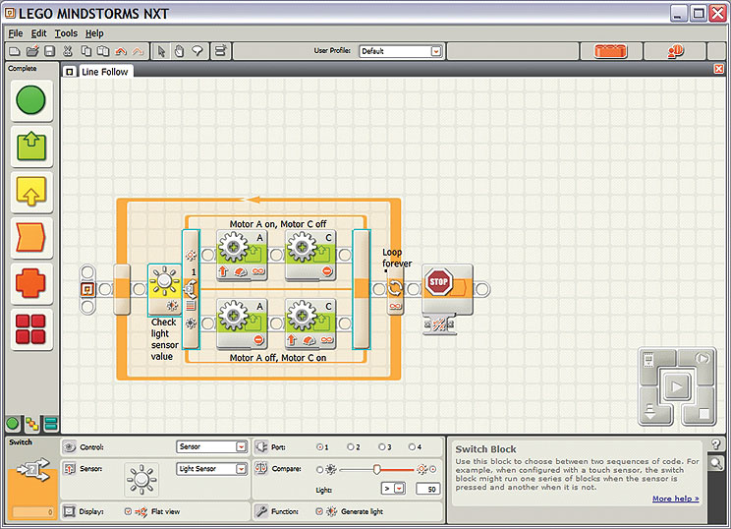
Robot Programming Interfaces (cont.)
Textual programming
Data flow programming (e.g. visual front-end for code)
Lego® Mindstorms® NXT-G Software
Anqi Xu, McGill University

Slide 6
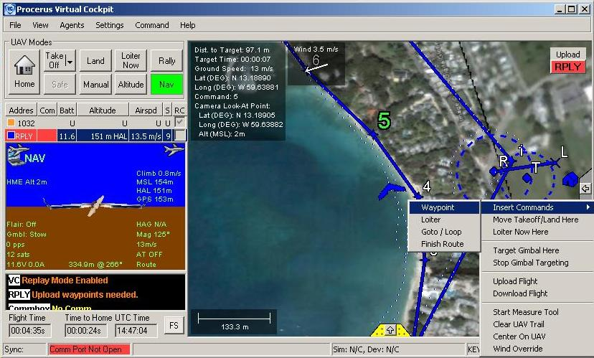
Robot Programming Interfaces (cont.)
Textual programming
Data flow programming (e.g. visual front-end for code)
Graphical control / tele-operation
Procerus® Virtual Cockpit™ Software
Anqi Xu, McGill University

Slide 7
Task Specification
Textual & data flow programming: if-then-else / switch
Full control over sequence of execution
Ability to specify branching paths
Nested clauses hard to debug
Graphical control: on-screen command selection
Commands placed at distinct locations on map
No path branching capabilities
Limited selection of tasks
Anqi Xu, McGill University

Slide 8
Graphical State-Space Programming (GSSP)
Insert waypoints through GUI
Location-specific tasks: standard computer code attached to waypoints
Branching & looping paths
Natural visualization of data flow
Core robot AI code decoupled from path itineraries
Minimal overlap of functionalities
High-level robot interaction
Anqi Xu, McGill University

Slide 9
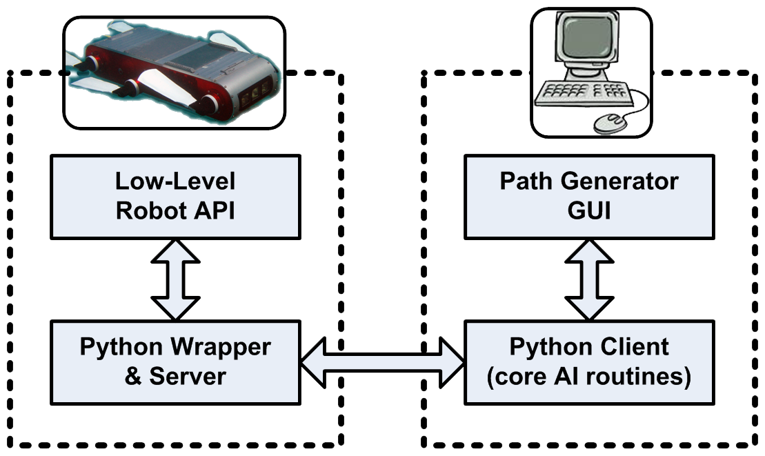
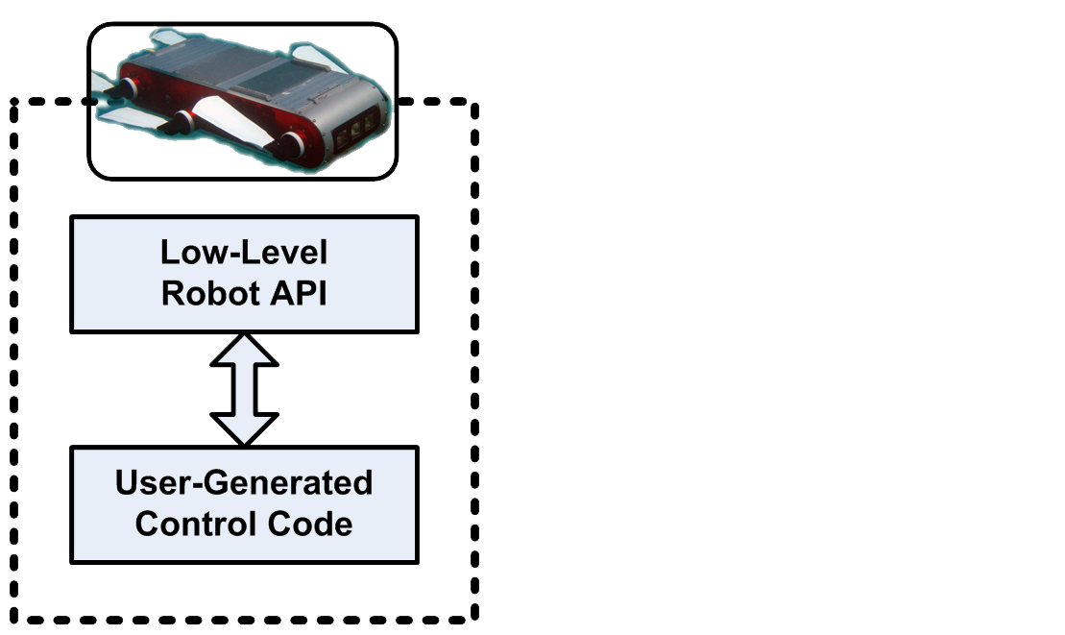
GSSP Implementation onboard Aqua
Existing development process
Long compilation times
Monolithic codebase
Limited on-board
processing capabilities
Revamped development process
Scripts interpreted at runtime using Python API wrapper
Modular client-server design
Upgradable client-side processing capabilities
Anqi Xu, McGill University

Slide 10
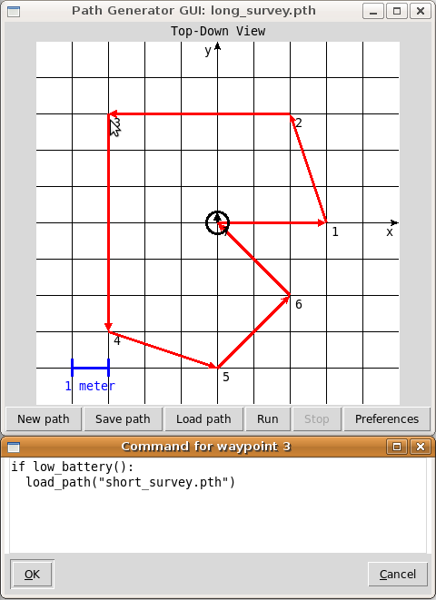
Path Generator GUI
Location-specific Python scripts
Load new paths within scripts
alternating routes
contingency plans
etc.
Create / modify paths at runtime
based on current state & latest observations
Anqi Xu, McGill University

Slide 11
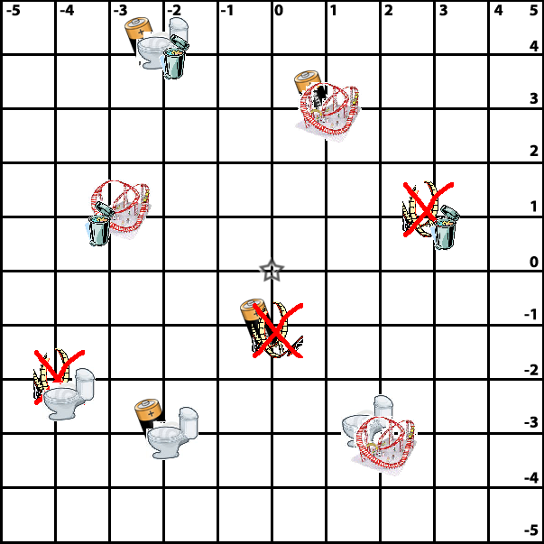
User Study
Graphical state-space programming versus textual scripting
Trajectory through all marked locations
Each icon corresponds to a specific action command
For textual scripting, use additional function calls to move robot
5 subjects, 4 sessions
Alternate between GSSP & textual interfaces
Evaluation metric: elapsed duration
Anqi Xu, McGill University

Slide 12
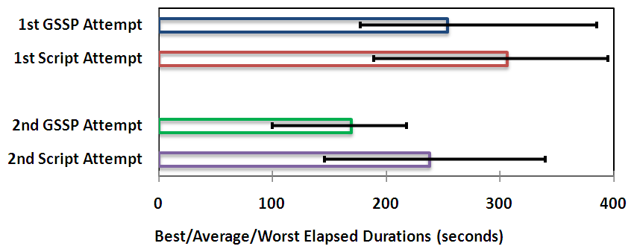
Study Results
GSSP interface consistently faster than procedural coding
GSSP has minimal learning overhead
GSSP’s high-level interaction prevents path-related & other simple programming errors
Anqi Xu, McGill University

Slide 13
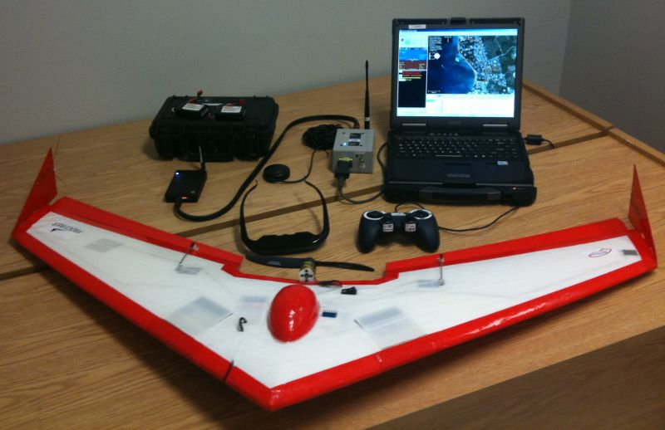
Conclusion
Graphical state-space programming paradigm
Geographical visualization of location-specific commands
Code for core AI routines decoupled from path itineraries
Advantages:
Smaller codebase
Faster development time
High-level robot interaction
Ongoing work:
Provide simultaneous visualization of branching paths
Integrate with other robotic platforms
Anqi Xu, McGill University

